Slide 1

Logistic Regression
A foundational Machine Learning algorithm for classification problems — predicting which category an input belongs to, not a continuous number.
Spam / Not Spam
Email classification
Fraud / Not Fraud
Transaction security
Disease / No Disease
Medical diagnosis
Pass / Fail
Student prediction
Input Features → Model → Probability → Class

Slide 2
Regression vs Classification
Linear Regression
Logistic Regression
Predicts a continuous numerical value.
Example: Years of Experience → Salary
Output: ₹65,000
Predicts the probability of belonging to a class.
Example: Hours Studied → Probability of Passing
Output: 0.87 → 87% probability of passing
Output is unbounded — can be any number on the number line.
Output is always between 0 and 1.
Probability → Classification Threshold → Class

Slide 3
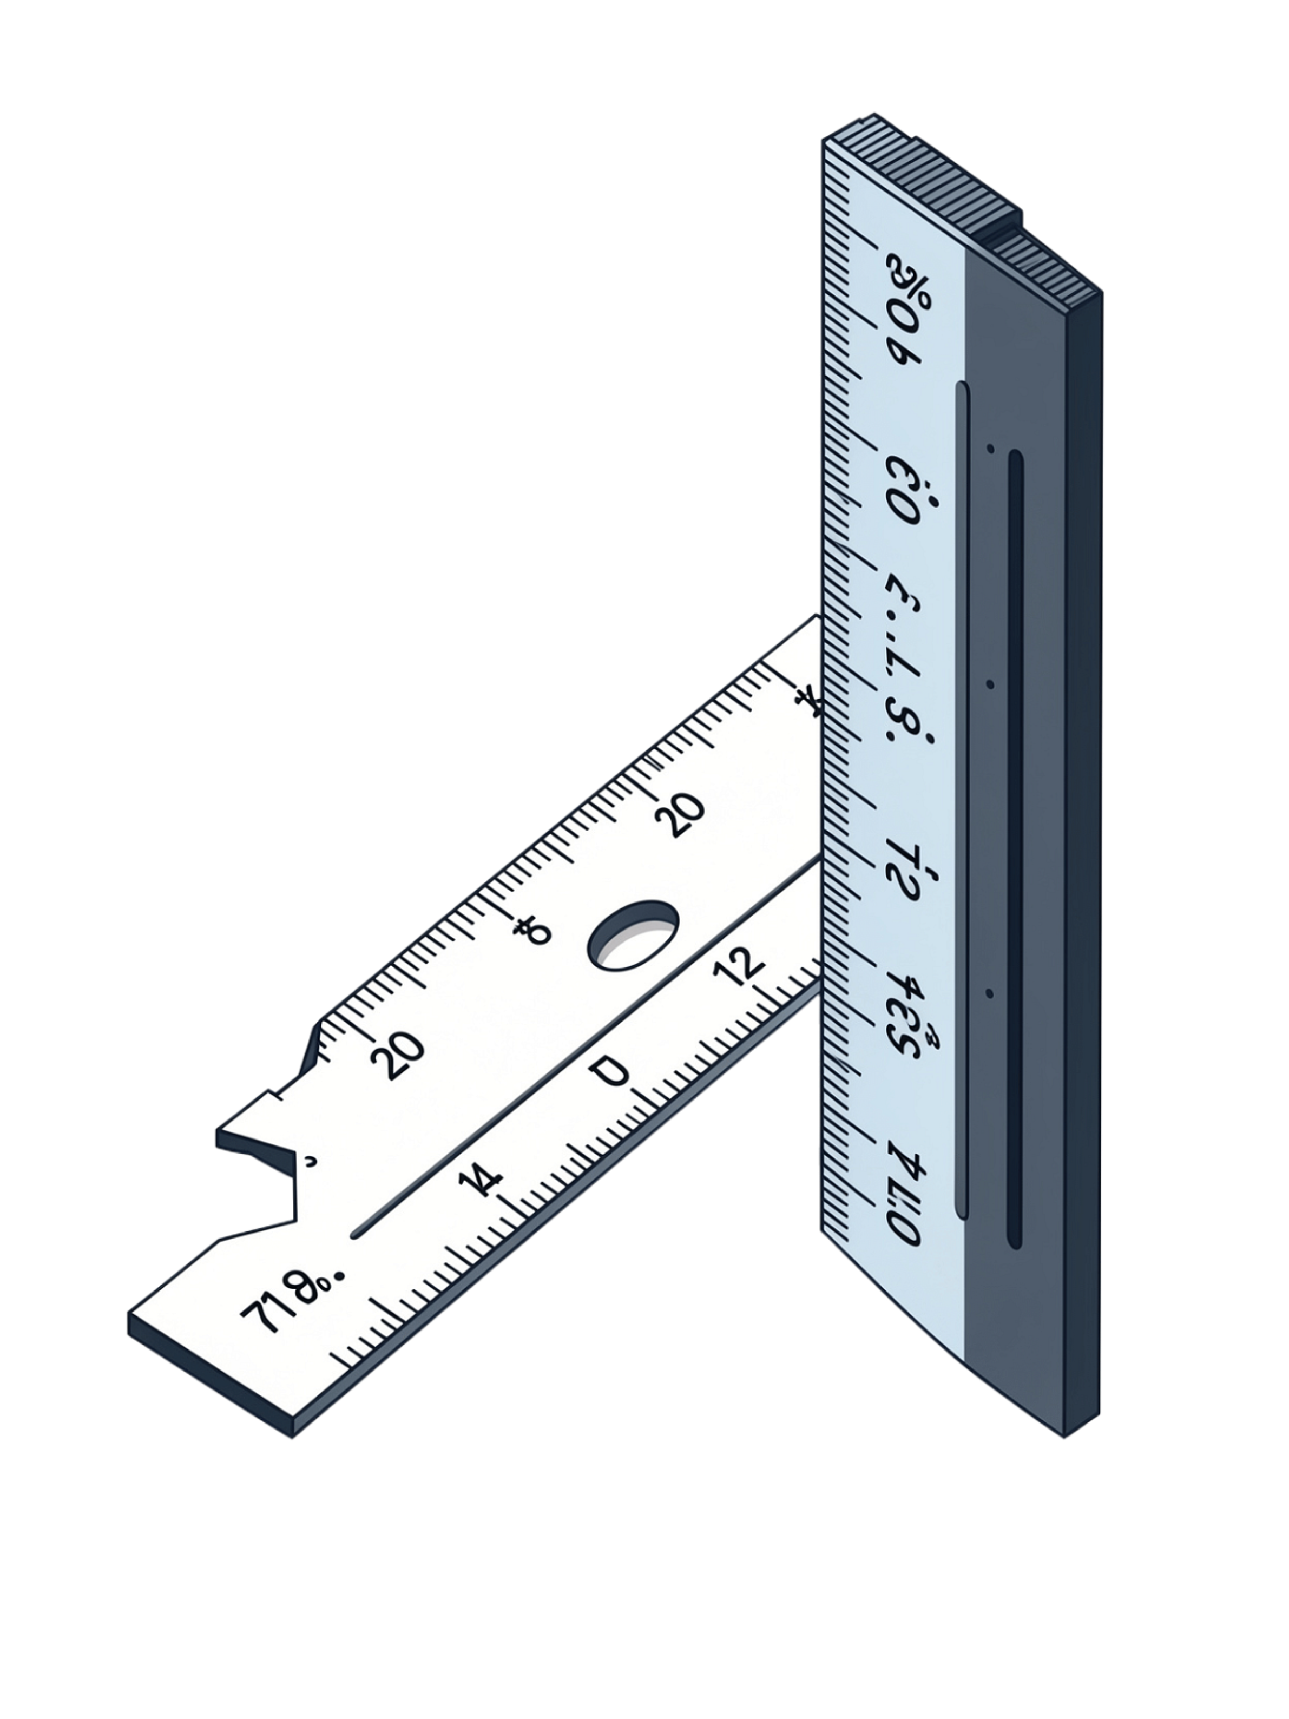

Why Can't We Directly Use Linear Regression?
Suppose we want to predict: 0 = Fail or 1 = Pass
Linear Regression can produce predictions such as:
Probabilities must always be between 0 and 1. Linear Regression does not guarantee this.
−0.4
We need a function that squashes any real number into the range [0, 1].
The solution: The Sigmoid Function — which maps every value of z to a probability between 0 and 1.
❌ Below 0
0.3
✅ Valid
0.8
✅ Valid
1.4
❌ Above 1

Slide 4
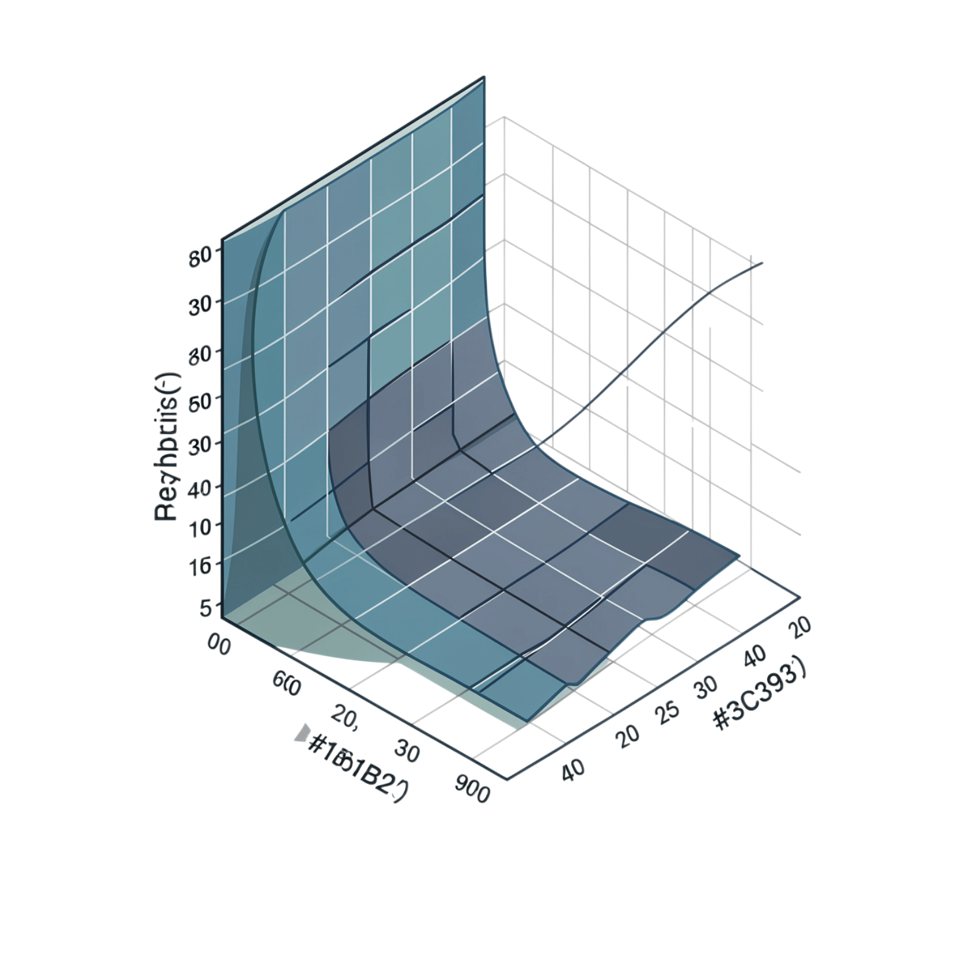

The Sigmoid Function
Every Component Explained
σ(z)
z
Sigmoid output — the predicted probability
Linear combination of input features: b₀ + b₁x₁ + … + bₙxₙ
e
−z
Euler's number ≈ 2.71828
Negative value of z — drives the S-shape
As z → +∞, σ(z) → 1. As z → −∞, σ(z) → 0. At z = 0, σ(z) = 0.5.

Slide 5
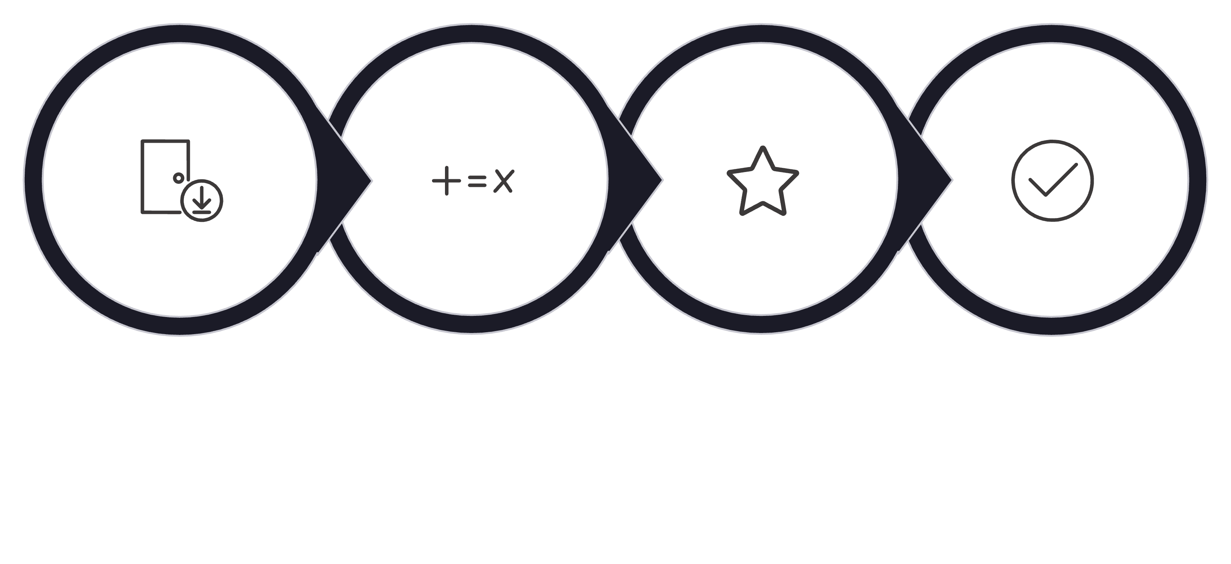
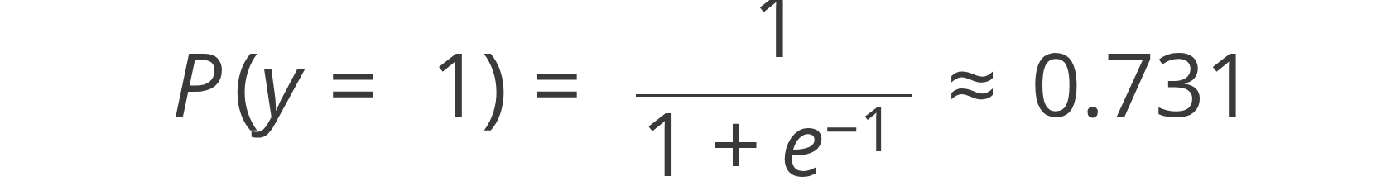
Complete Mathematical Example
Predict whether a student will pass based on study hours.
Step 1 — Define the Linear Equation
Where x = Hours Studied, coefficient = 2, intercept = −5
Step 2 — Plug in x = 3 hours
Step 3 — Apply the Sigmoid
Input: x=3
Linear: z=1
Sigmoid: σ(z)=0.731
Class: PASS
Step 4 — Apply Threshold (0.5)
The probability of 73.1% exceeds the 0.5 threshold, so the model confidently predicts PASS.
0.731 > 0.5 → Prediction = PASS ✅

Slide 6

Classification Threshold
The model outputs a probability. A threshold converts it into a class label.
Common Threshold: 0.5
Probability | Threshold | Prediction
0.92 | 0.5 | Class 1 — PASS
0.73 | 0.5 | Class 1 — PASS
0.50 | 0.5 | Class 1 — PASS
0.49 | 0.5 | Class 0 — FAIL
0.21 | 0.5 | Class 0 — FAIL
Probability ≥ 0.5
Probability < 0.5
→ Predict Class 1 (Positive)
→ Predict Class 0 (Negative)
The threshold can be adjusted depending on the problem. A medical test may use 0.3 to catch more true positives.

Slide 7





Logistic Regression with Multiple Features
Example: Predict whether a customer will churn.
Monthly Charges
Higher charges → higher churn risk. Positive coefficient.
Tenure
Longer tenure → lower churn risk. Negative coefficient.
Support Calls
More calls → higher churn risk. Positive coefficient.
Contract Type
Long-term contract → lower churn risk. Negative coefficient.

Slide 8
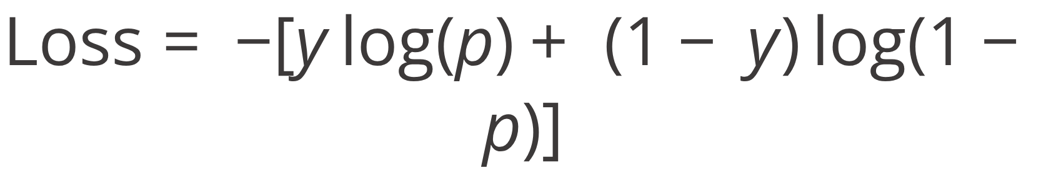
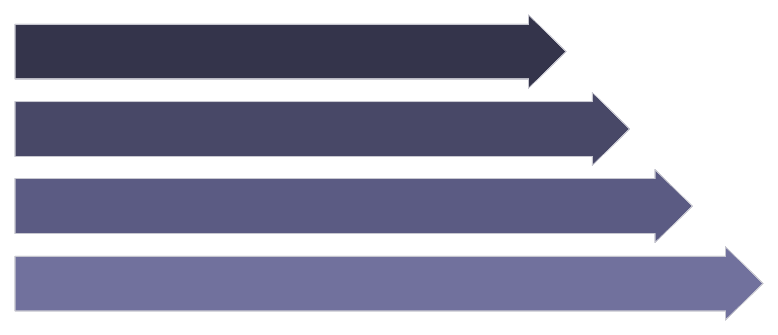


How Logistic Regression Learns
Log Loss / Binary Cross-Entropy
Training Data
y
Calculate z
Actual class label (0 or 1)
Apply Sigmoid
p
Predicted probability from sigmoid
Generate Probability
Confidently incorrect predictions receive a very large penalty. The model learns by minimizing this loss.

Slide 9
Model Evaluation
Confusion Matrix
Key Evaluation Metrics
 | Predicted: 1 | Predicted: 0
Actual: 1 | True Positive (TP) | False Negative (FN)
Actual: 0 | False Positive (FP) | True Negative (TN)
Accuracy
(TP + TN) / Total — overall correctness
Precision
TP / (TP + FP) — of predicted positives, how many are correct?
Example: Disease Detection — False Negatives are especially costly. Accuracy alone may not be sufficient.
Recall
TP / (TP + FN) — of actual positives, how many did we catch?
F1 Score
Harmonic mean of Precision and Recall

Slide 10

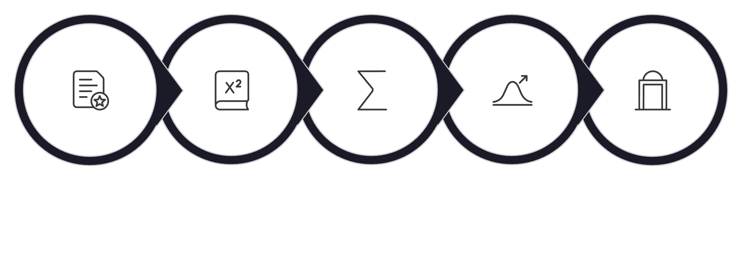
Summary & Real-World Applications
Real-World Applications
The Core Pipeline
Spam Detection
Email → Spam / Not Spam
Fraud Detection
Transaction → Fraud / Legitimate
Medical Diagnosis
Features
Linear z
Sigmoid σ(z)
Probability
Threshold
Symptoms → Disease / No Disease
Customer Churn
Core Formula
Behaviour → Churn / No Churn
Loan Default
Profile → Default / No Default

Slide 11






Key Takeaways
Classification First
Outputs Probabilities
Logistic Regression is primarily a classification algorithm despite its name.
The model always outputs a value between 0 and 1 — a probability.
Sigmoid is Key
Threshold Decides Class
The Sigmoid function squashes any real number into the [0, 1] range.
A threshold (default 0.5) converts probability into a final class label.
Multiple Features
Evaluate Carefully
Real models use many features, each with its own learned coefficient.
Use Precision, Recall, F1, and a Confusion Matrix — not just Accuracy.
Features → Logistic Regression → Probability → Threshold → Class

